Slide 1


Development of Application Software for Water System Data Management, Visualization, and Analysis with the Shiny Framework
Nick Zinck
Notes:
My project is titled “Development of Application Software for Water System Data Management, Visualization, and Analysis with the Shiny Framework.
This project is a collaboration of UMass Amherst and the Department of Conservation and Recreation, referred to as the DCR.
So I am going to show a slide show for about 10 minutes and then I will show and demonstrate one of my applications

Slide 2
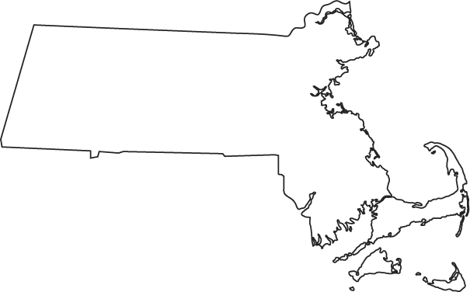
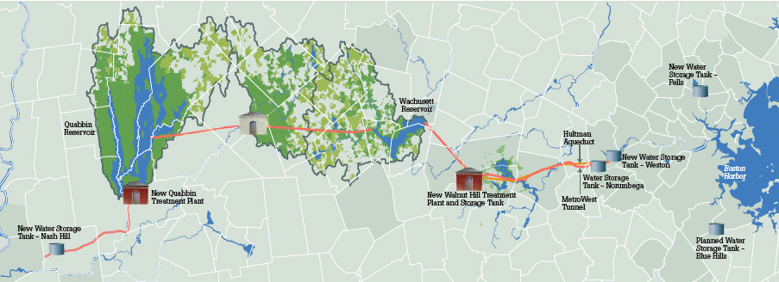
Water Supply System
Water supply system for Boston metropolitan area managed by the MWRA and DCR
Notes:
For a brief background, The water supply system that serves the Boston metropolitan area is managed by the Massachusetts Water Resources Authority, or the MWRA
The sources of water for the system are the Quabbin Reservoir, Wachusett Reservoir, and occasionally the Ware River.
The DCR manages and protects these three watersheds which combined have a total area of about 400 square miles and consist of predominantly forested area.
The system also consists of an aqueduct system and treatment facilities.

Slide 3
Water Supply System
Quabbin Reservoir Capacity: | 412 billion gallons
Wachusett Reservoir Capacity: | 65 billion gallons
Daily Demand: | ~ 200 MGD
Notes:
The water supply system services over ____ people.
It averages MGD
MGD?
People served

Slide 4
Watershed Info
Quabbin Reservoir Capacity: | 412 billion gallons
Wachusett Reservoir Capacity: | 65 billion gallons
Daily Demand: | ~ 200 MGD
Notes:
Add tables from background

Slide 5
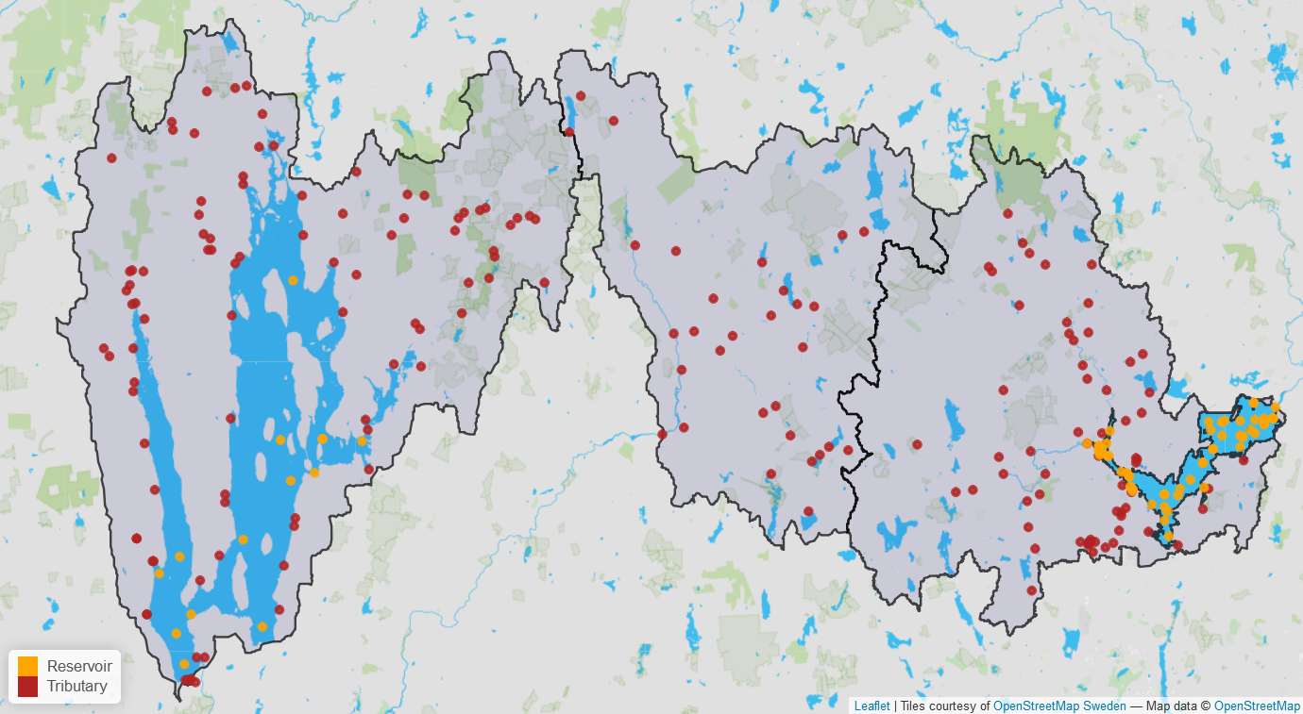
Sampling Locations
Notes:
In order to protect and manage the reservoirs and watershed, the DCR collects data of the water system through sampling.
This picture shows all the documented sampling locations of the DCR.
Sampling is conducted in the Reservoirs and Tributaries and include both water quality and water quantity measurements

Slide 6
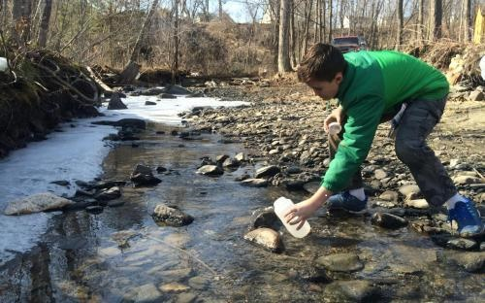
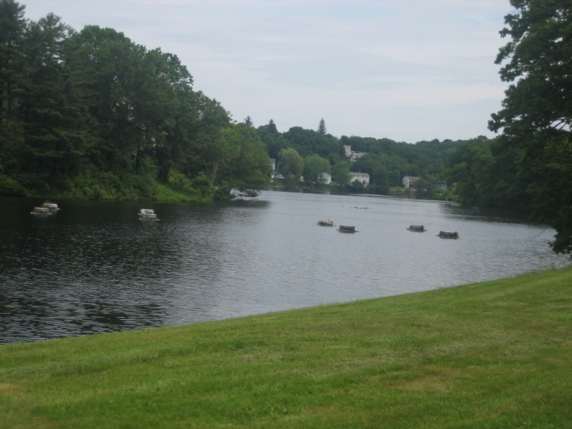
Tributary Water Quality Sampling
Water Quality
In-field measurements
Grab samples for lab testing
Water Quantity
Continuous Stage Measurement
Periodic Flow Measurements
Notes:
Tributary Water Quality Sampling includes both in-field measurements as well as grab samples which are sent to a lab for testing.
Tributary Water Quantity Sampling includes stream gauges for continuous stage measurements which are used to estimate flow based on calibrated stage-discharge relationships, or in other words rating curves.
In general, the stream flow gauges of the larger tributaries are managed by the USGS, and the smaller tributaries are managed by the DCR .

Slide 7
Tributary Water Quantity Sampling
Water Quality
In-field measurements
Grab samples for lab testing
Water Quantity
Continuous Stage Measurement
Periodic Flow Measurements
Notes:
Tributary Water Quality Sampling includes both in-field measurements as well as grab samples which are sent to a lab for testing.
Tributary Water Quantity Sampling includes stream gauges for continuous stage measurements which are used to estimate flow based on calibrated stage-discharge relationships, or in other words rating curves.
In general, the stream flow gauges of the larger tributaries are managed by the USGS, and the smaller tributaries are managed by the DCR .

Slide 8
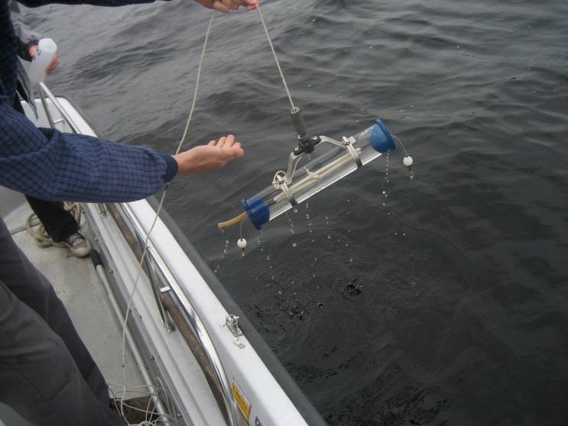
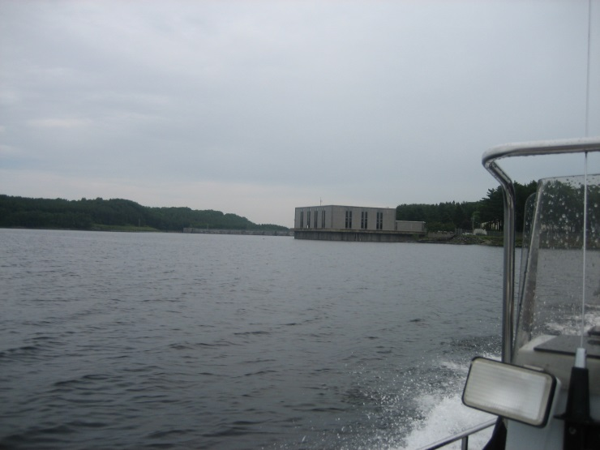
Reservoir Sampling
Water Quality
Grab samples
In-field Profile Probe Sampling
Water Quantity
Water Elevation
Notes:
Most Reservoir water quality sampling is done by boat and includes reservoir grab sampling and profile probe sampling.
Additionally, the MWRA conducts Continuous water quality measurements by buoys
The water elevation of the reservoirs are recorded daily which are used to estimate total volume of each reservoir

Slide 9
Objective
Facilitate entry, query, visualization, and analysis of water system data
Notes:
The main objective of this project is to facilitate entry, query, visualization, and analysis of water system data

Slide 10
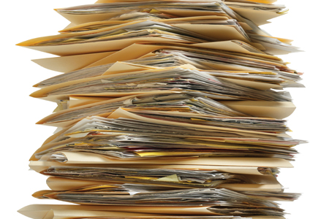

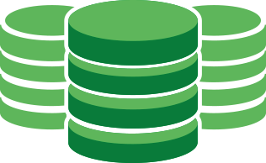
Big Data
Paper Records
Spreadsheets
Databases
Notes:
All of this sampling produces a large volume of water system data from a variety of sources.
Paper records and excel spreadsheets are not an effective way of storing and managing this data
A Relational database management system is a much better solution.
Part of my work on this project has been to move and organize data into a central database
Big Data Requirement
Volume - The amount of data.
Velocity - The speed at which it is acquired.
Variety - The format of the data. (numeric data, text documents, etc.)
Variability - The inconsistencies in the flow of data reporting.
Complexity - The number of different sources incorporated into an analysis.

Slide 11
Tidy Data

Slide 12

Notes:
Database software paired with a compatible application specialized for data querying, visualization, and analysis is an effective tool for an organization which collects various water system data.

Slide 13

Applications
WIT
Water System Data Import Tool
WAVE
Water System Data Analysis and Visualization Environment
Notes:
To meet this objective, I created two applications.
The first application is named WIT, which stands for Water System data Import Tool.
WIT is designed to process water system data and import this data into a database
The second application is named WAVE, which stands for Water System data Analysis and Visualization Environment.
WAVE is designed to facilitate viewing, visualizing, and analyzing water system data.
I’ve unfortunately only had time to make a logo for one of them, so if anyone wants to be creative and draw up a logo for WIT be my guest

Slide 14
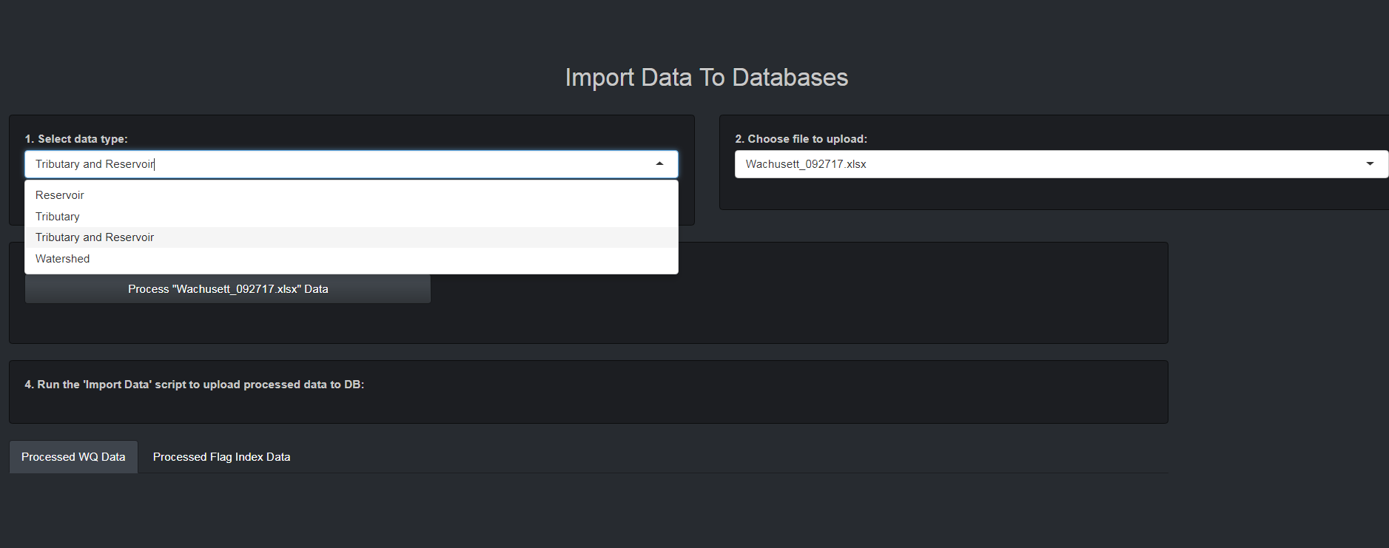

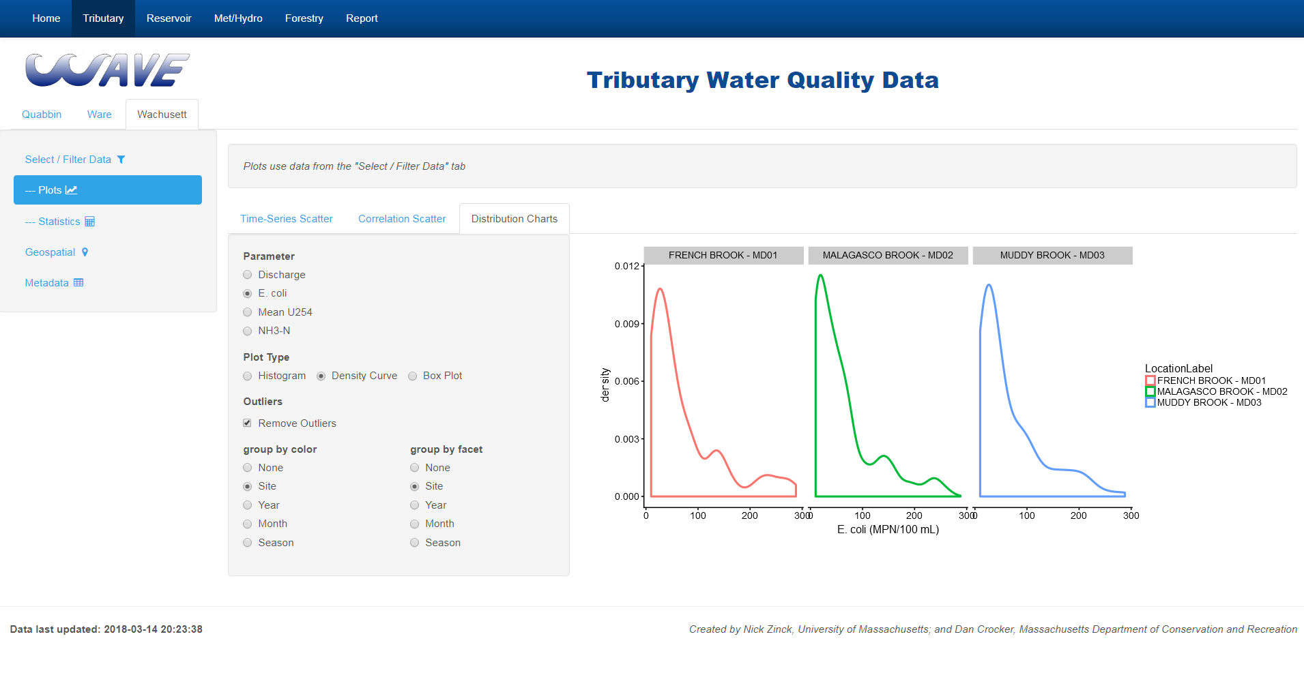
WIT
Notes:
Both Applications are actually being used currently at the DCR, and plan to be continuously updated in the foreseeable future.
WIT and WAVE are both launched locally on a DCR computer by the click of a desktop icon and will automatically be opened in a Google Chrome Web Browser.

Slide 15
Notes:
How it started
Explain Development process back and forth

Slide 16





Application Frameworks for Data
R
Shiny (RStudio)
Python
Bokeh (Anaconda)
Dash (Plotly)
Notes:
Both of the applications were developed with the Shiny Development Framework, created by RStudio, in the R programming language
Shiny allows someone with R experience, but little application development experience, to create their own application.
There are also similar data development frameworks in the Python Programming Language which include Bokeh and Dash.

Slide 17
WIT
Notes:
I am first going to talk about WIT

Slide 18
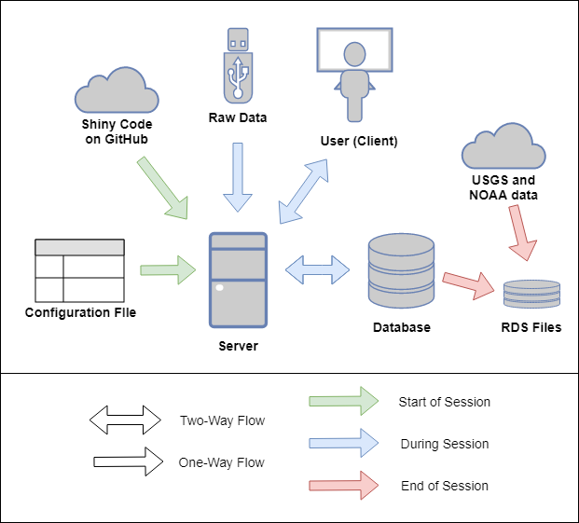
WIT Architecture
Notes:
This diagram shows the basic system architecture of the main pieces of the WIT application.
These pieces include the configuration file, Application Code on GitHub, Server, User/Client, Raw Data, and Data Storage
The green arrow indicates the pieces of the WIT application active during the starting of WIT
Blue arrows for during the session, and red arrows after the session ends.

Slide 19
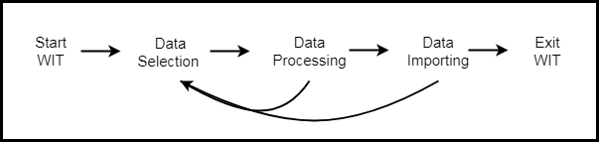
WIT Architecture
Notes:
A more detailed description of the sequence of events from when a user opens WIT to when they exit the app.
Just as the system architecture diagram, the colors represent the start, during, and end of session
(Color Code Flow Chart)

Slide 20
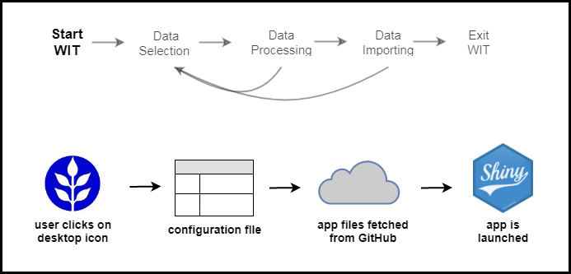
WIT User Flow
Start WIT
Notes:
When the user opens WIT, a configuration file is read which contains user settings.
The Application code is then fetched from a GitHub account in the cloud.
This ensures that every time the user opens the application, it is automatically the most up-to-date version.

Slide 21
WIT User Flow
Data Selection
Notes:
During the session, the user is able to select raw data files on their computer which have been stored in designated folder’s on the internal DCR network.
The user first selects a data source type and raw data file and then a “process data” button will appear on the screen.

Slide 22
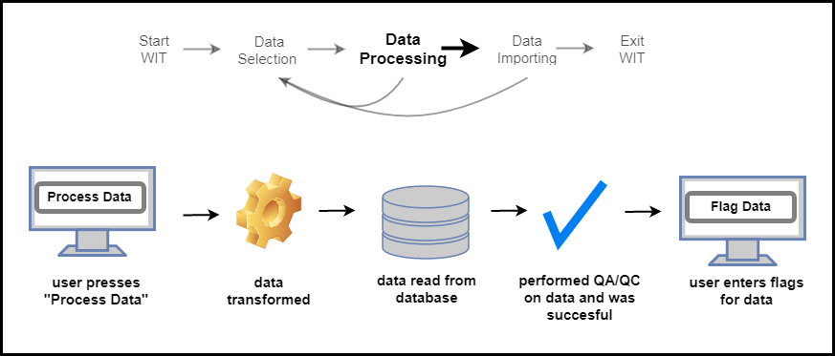
WIT User Flow
Successful Data Processing
Notes:
(Make an Image of it before QA/QC. Remove Check and put a QA/QC symbol instead)
The process data button will run an R script, specific to the data source type, to transform the data into the desired database format.
The data from the database is also read in to ensure that the raw data that the user is trying to upload has not already been uploaded to the database.
This is to prevent any duplicate records
WIT also performs other Quality Control checks on the data.
Most are specific to each data source type.

Slide 23
WIT User Flow
Successful Data Processing
Notes:
If the Quality Control Checks ARE met, an import button will appear and the user will be able to view the transformed data in a table.

Slide 24
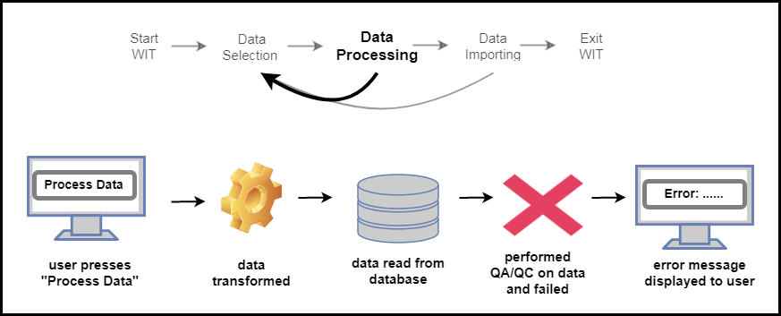
WIT User Flow
Unsuccessful Data Processing
Notes:
If the quality control checks are not met, then the user will be notified with the reason for the error and can try to fix the problem in the raw data file.

Slide 25
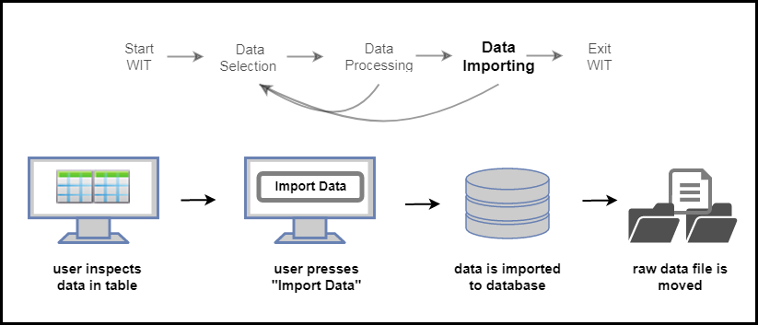
WIT User Flow
Data Importing
Notes:
If the user is satisfied, they can click the import button which will run an R script to add the data to the correct location in the database.
The raw data file is moved to another designated folder so a user will not attempt to re-upload it in the future.

Slide 26
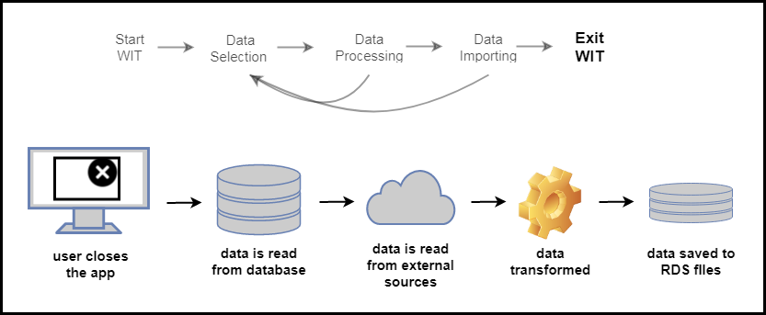
WIT User Flow
Exit WIT
Notes:
Lastly, When the user exits out of the browser, an R script is ran to update the water system data stored in RDS files which are the most efficient way to save data from R and load data into R.
The RDS files store the water system data that the WAVE application uses which includes data from the DCR databases as well as from external sources like NOAA and the USGS.

Slide 27
Notes:
Now moving on to WAVE

Slide 28

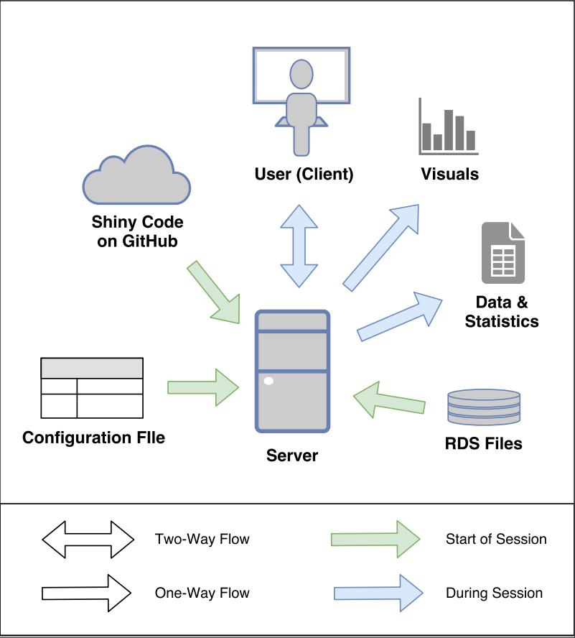
Architecture
Notes:
When the user opens WAVE, just like WIT, a configuration file is read and the code is fetched from GitHub.
The RDS files that contain the water system data, as previously mentioned, are also read in at the start of the session.

Slide 29
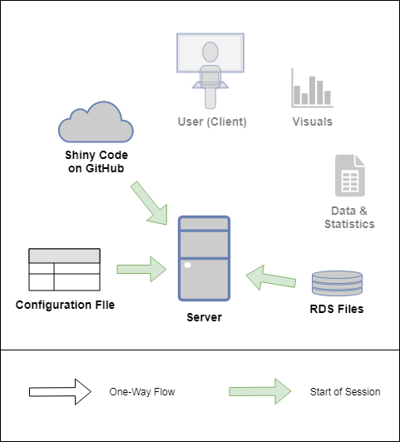
Architecture
Notes:
(Find this text on my laptop/external hd)
When the user opens WAVE, just like WIT, a configuration file is read and the code is fetched from GitHub.
The RDS files that contain the water system data, as previously mentioned, are also read in at the start of the session.

Slide 30
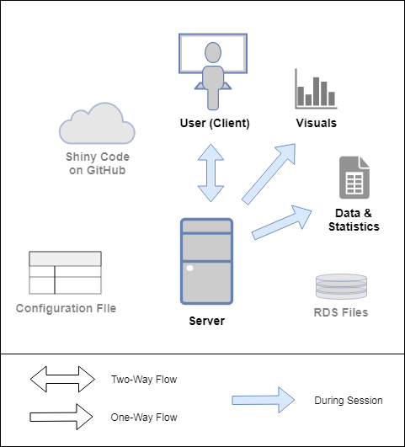
Architecture
Notes:
During the session the user has the ability to view, visualize, and analyze water system data, and also output these tables or figures.
The application does not try to answer any specific water quality or water quantity question, yet will hopefully facilitate a user’s ability to answer a wide variety of questions in the future.

Slide 31
WAVE Code
Main Script – Tabular Structure
Module Scripts – Specific Features/Dashboards
Modules:
Filter | Plots | Plot Options | Statistics | Metadata | Other
Filter WQ | Plot Time WQ | Plot Save | Summary Stats | Location | Home
Parameter Select | Plot Corr WQ | Plot Hline | Pearson Corr | Parameter | Phytoplankton
Date Select | Distribution | Plot Vline |  | Flags | Map Plot
Checkbox Select All | Profile Heatmap | Plot Text |  | Flag Sample Index | Report
Select Select All | Profile Line Plot
Notes:
WAVE can be thought of as a tabulated series of dashboards.
The WAVE Code structure is set up in a way that the main script file defines the overall tabular layout of the application.
Each individual dashboard is written in an independent, separate script, called a module.
The list of modules are shown in the table.
Separating code into multiple files is key for organization and to decrease code repetition.

Slide 32
Notes:
Talk about how this makes it easier to add too!

Slide 34
Architecture
Notes:
With the remainder of the time, I will demonstrate the Application.
The application is not yet a completely finished product, and is built in a way to allow for seamless additions in the future.

Slide 35
Thank You
UMass
Dr. Tobiason
Dr. Gleason
Dr. Kumpel
DCR
Dan Crocker
Questions?
Notes:
I want to thank all of the staff at the DCR for being supportive of this project.
And a special thanks to Dan Crocker who helped me develop these applications.
Thank you to UMass, and special thanks to my advisor Dr. Tobiason
Also, if anyone wants to learn more about making a data App feel free to reach out to me.
These data apps do not have to be as complex and can be used for smaller scale data apps
Any Questions?

